Slide 1

Notes:
Maya Angelou was an American memoirist, poet, and civil rights activist. She published seven autobiographies, three books of essays, several books of poetry, and is credited with a list of plays, movies, and television shows spanning over 50 years. She received dozens of awards and more than 50 honorary degrees. - Wikipedia

Slide 2
Module 09: Continuous Random Variables & Probability Distributions

Slide 3
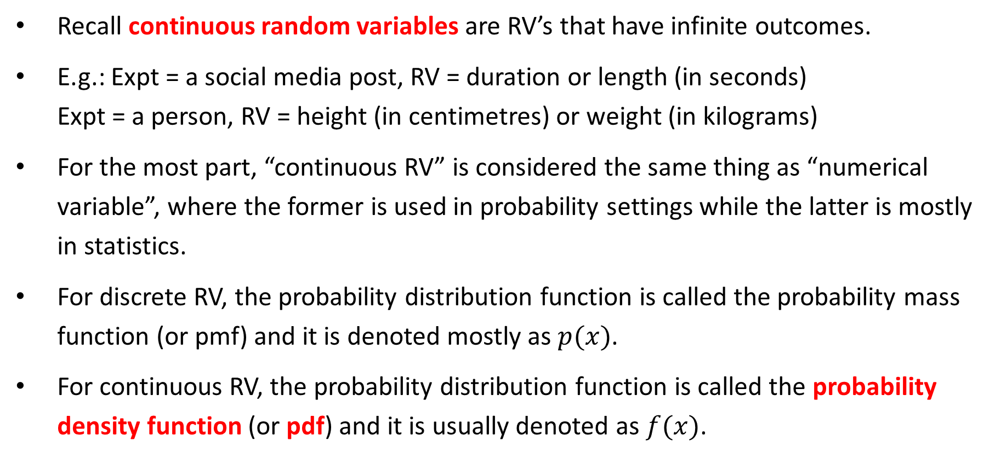
Continuous RV & Distributions
Recall continuous random variables are RV’s that have infinite outcomes.
E.g.: Expt = a social media post, RV = duration or length (in seconds) Expt = a person, RV = height (in centimetres) or weight (in kilograms)
For the most part, “continuous RV” is considered the same thing as “numerical variable”, where the former is used in probability settings while the latter is mostly in statistics.
For discrete RV, the probability distribution function is called the probability mass function (or pmf) and it is denoted mostly as $p(x)$.
For continuous RV, the probability distribution function is called the probability density function (or pdf) and it is usually denoted as $f(x)$.

Slide 4
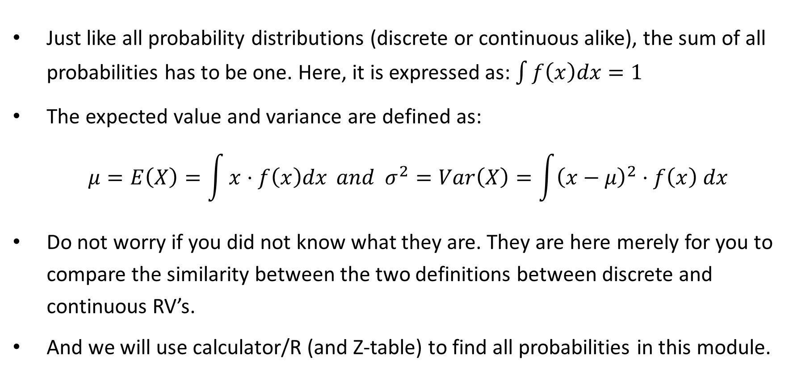
E(X) and Var(X)
Just like all probability distributions (discrete or continuous alike), the sum of all probabilities has to be one. Here, it is expressed as: $\int{f\left(x\right)dx=1}$
The expected value and variance are defined as:
$$μ=E\left(X\right)=\int{x⋅f\left(x\right)dx} and σ^{2}=Var\left(X\right)=\int{{\left(x−μ\right)}^{2}⋅f\left(x\right) dx}$$
Do not worry if you did not know what they are. They are here merely for you to compare the similarity between the two definitions between discrete and continuous RV’s.
And we will use calculator/R (and Z-table) to find all probabilities in this module.

Slide 5
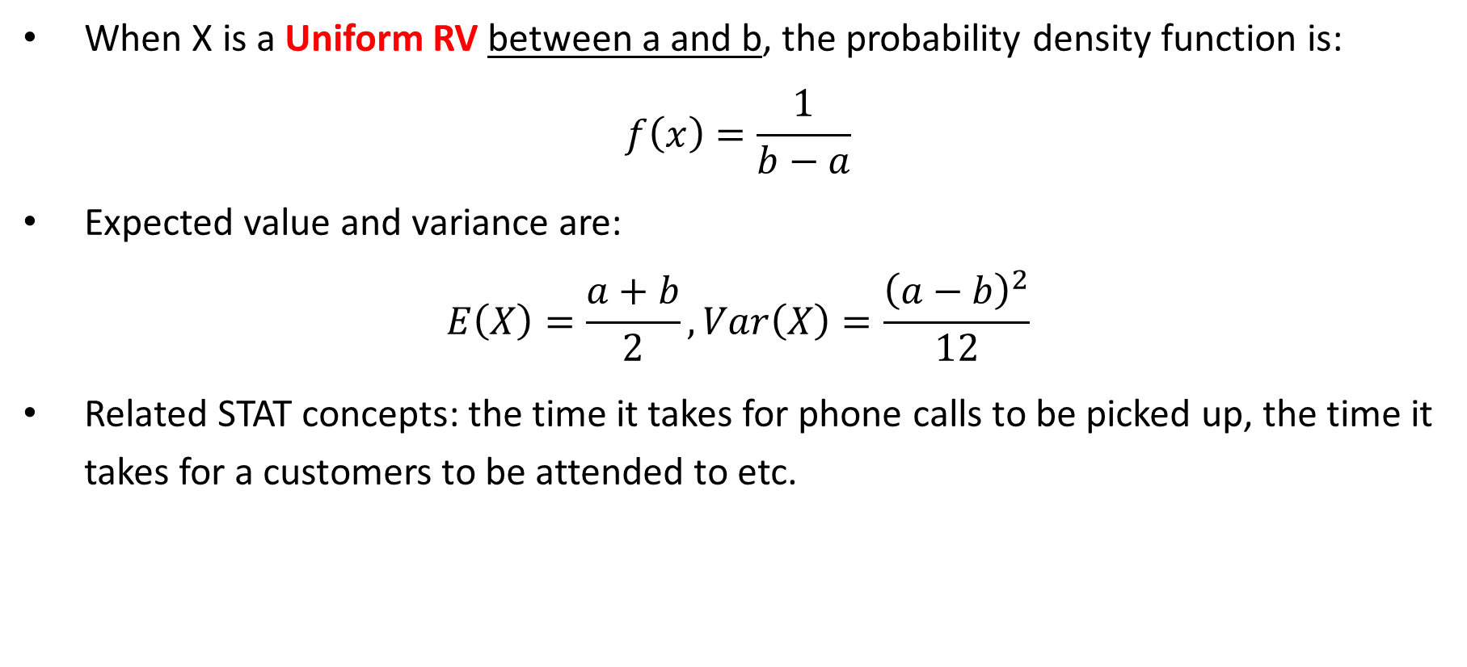
(Continuous) Uniform RV & Distributions
When X is a Uniform RV between a and b, the probability density function is:
$$f\left(x\right)=\frac{1}{b−a}$$
Expected value and variance are:
$$E\left(X\right)=\frac{a+b}{2}, Var\left(X\right)=\frac{{\left(a−b\right)}^{2}}{12}$$
Related STAT concepts: the time it takes for phone calls to be picked up, the time it takes for a customers to be attended to etc.

Slide 6
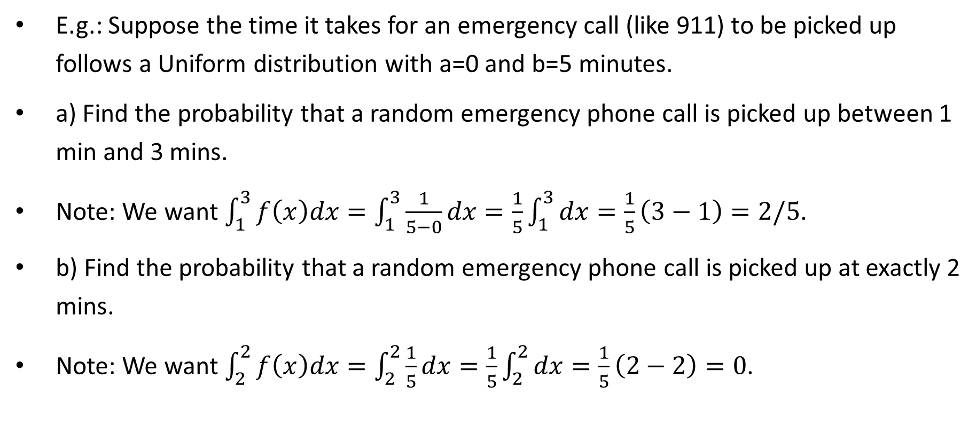
Uniform Probability Calculations
E.g.: Suppose the time it takes for an emergency call (like 911) to be picked up follows a Uniform distribution with a=0 and b=5 minutes.
a) Find the probability that a random emergency phone call is picked up between 1 min and 3 mins.
Note: We want $\int_{1}^{3}{f\left(x\right)dx}=\int_{1}^{3}{\frac{1}{5−0}}dx=\frac{1}{5}\int_{1}^{3}{dx}=\frac{1}{5}\left(3−1\right)=2/5$.
b) Find the probability that a random emergency phone call is picked up at exactly 2 mins.
Note: We want $\int_{2}^{2}{f\left(x\right)dx}=\int_{2}^{2}{\frac{1}{5}}dx=\frac{1}{5}\int_{2}^{2}{dx}=\frac{1}{5}\left(2−2\right)=0$.
Notes:
Instead of using integration, we could also do that by “finding the areas of the rectangle”.
With a = 0 and b = 5, f(x) = 1/5.
a) It’s a two-minute period between 1 min and 3 mins, then the probability is 2/5.
b) Note the “base” is zero, so the area or probability is 0.

Slide 7
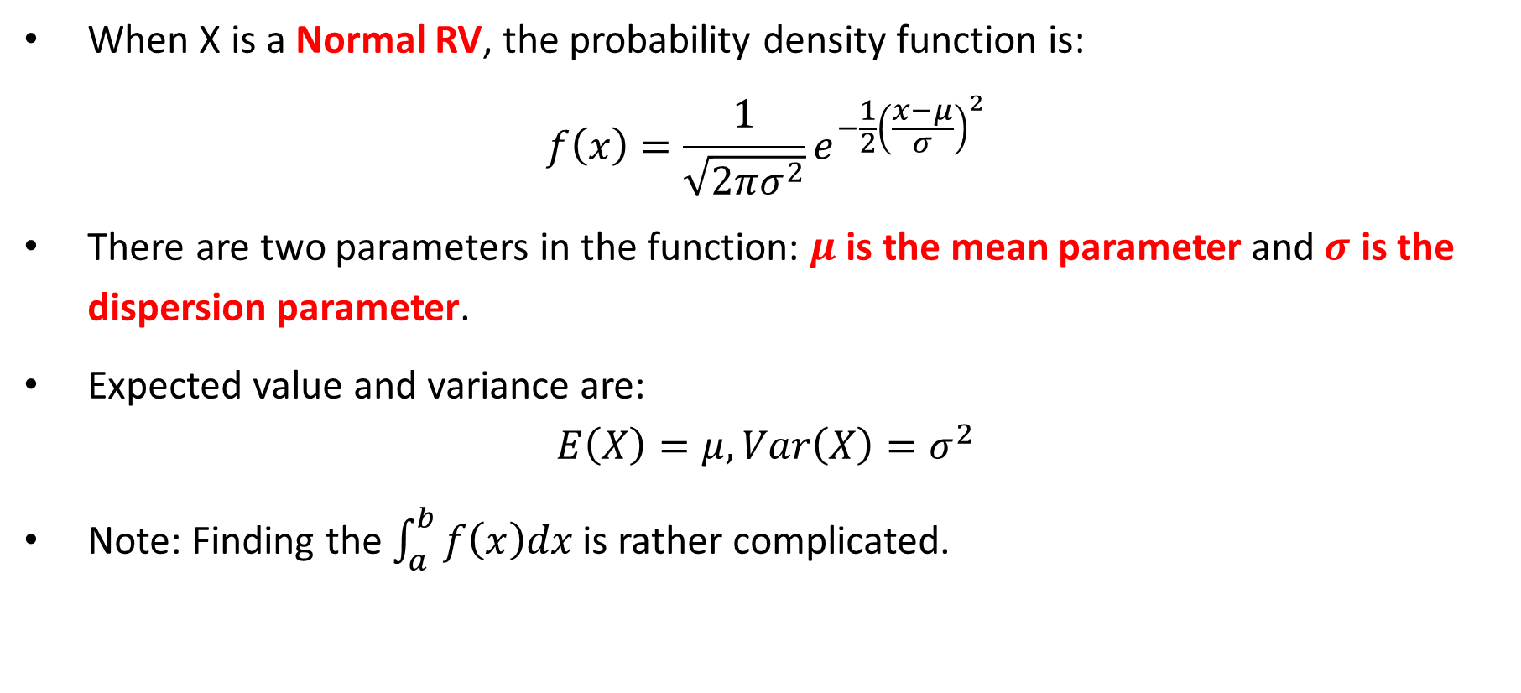
General Normal RV & Distributions
When X is a Normal RV, the probability density function is:
$$f\left(x\right)=\frac{1}{\sqrt{2πσ^{2}}}e^{−\frac{1}{2}{\left(\frac{x−μ}{σ}\right)}^{2}}$$
There are two parameters in the function: $μ$ is the mean parameter and $σ$ is the dispersion parameter.
Expected value and variance are:
$$E\left(X\right)=μ, Var\left(X\right)=σ^{2}$$
Note: Finding the $\int_{a}^{b}{f\left(x\right)dx}$ is rather complicated.

Slide 8
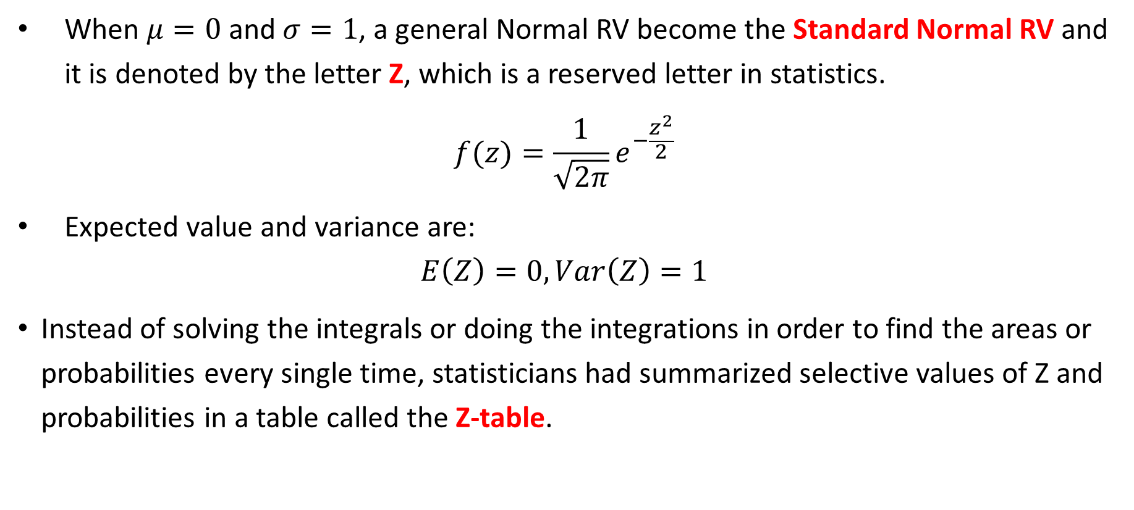
Standard Normal RV & Distributions
When $μ=0$ and $σ=1$, a general Normal RV become the Standard Normal RV and it is denoted by the letter Z, which is a reserved letter in statistics.
$$f(z)=\frac{1}{\sqrt{2π}}e^{−\frac{z^{2}}{2}}$$
Expected value and variance are:
$$E\left(Z\right)=0, Var\left(Z\right)=1$$
Instead of solving the integrals or doing the integrations in order to find the areas or probabilities every single time, statisticians had summarized selective values of Z and probabilities in a table called the Z-table.

Slide 9
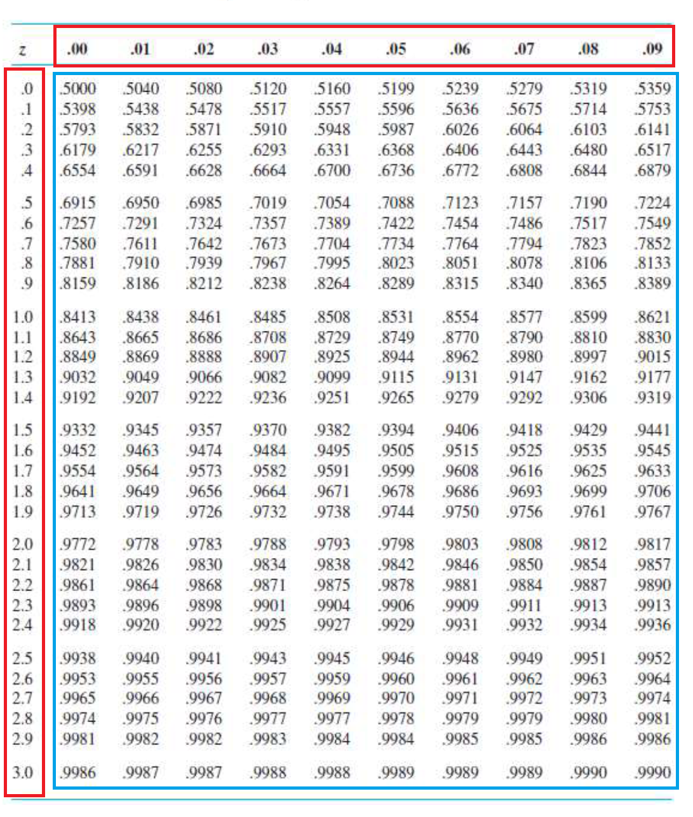
Z-Table
The Standard Normal Table or the Z-Table has two main parts.
1) Cumulative area or it’s usually called left-hand area, in the middle of the table (blue)
2) Z-score, on the top row and left column of the table (red)
When you have one, you will find the other one!

Slide 10
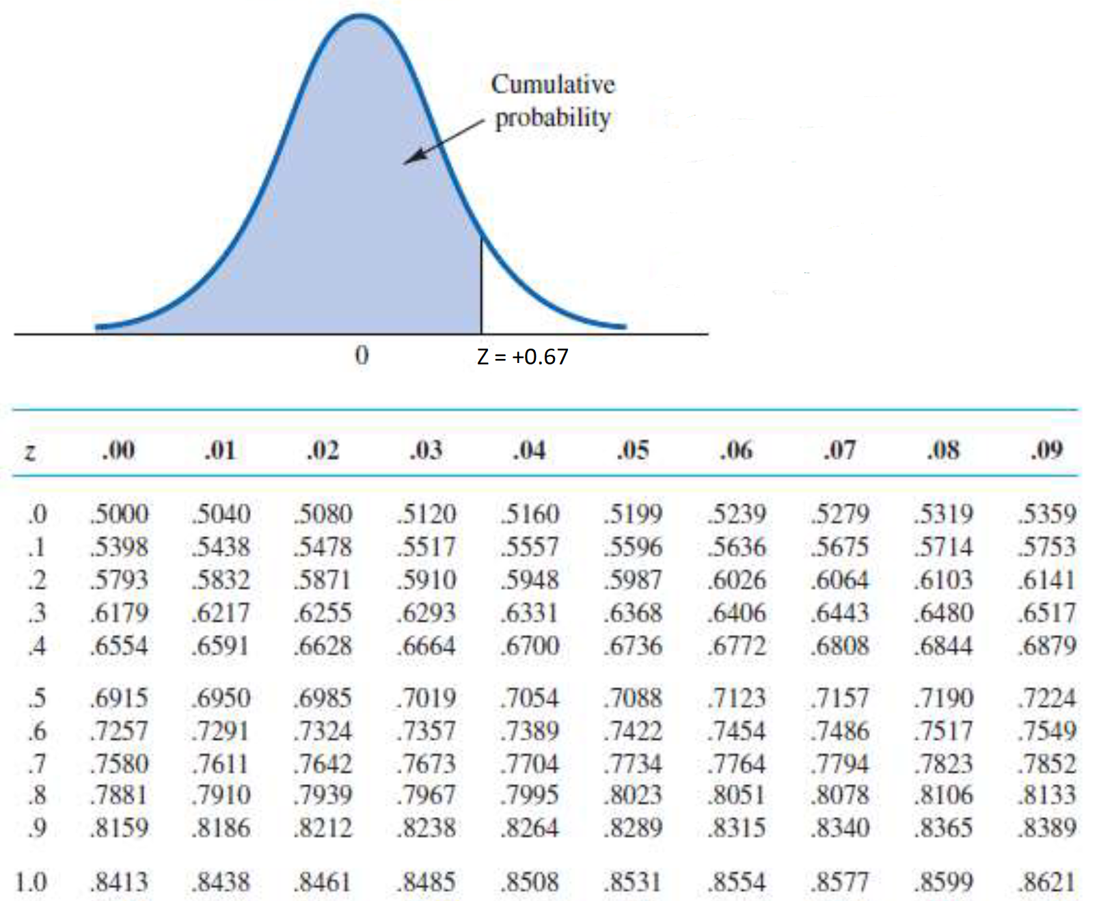
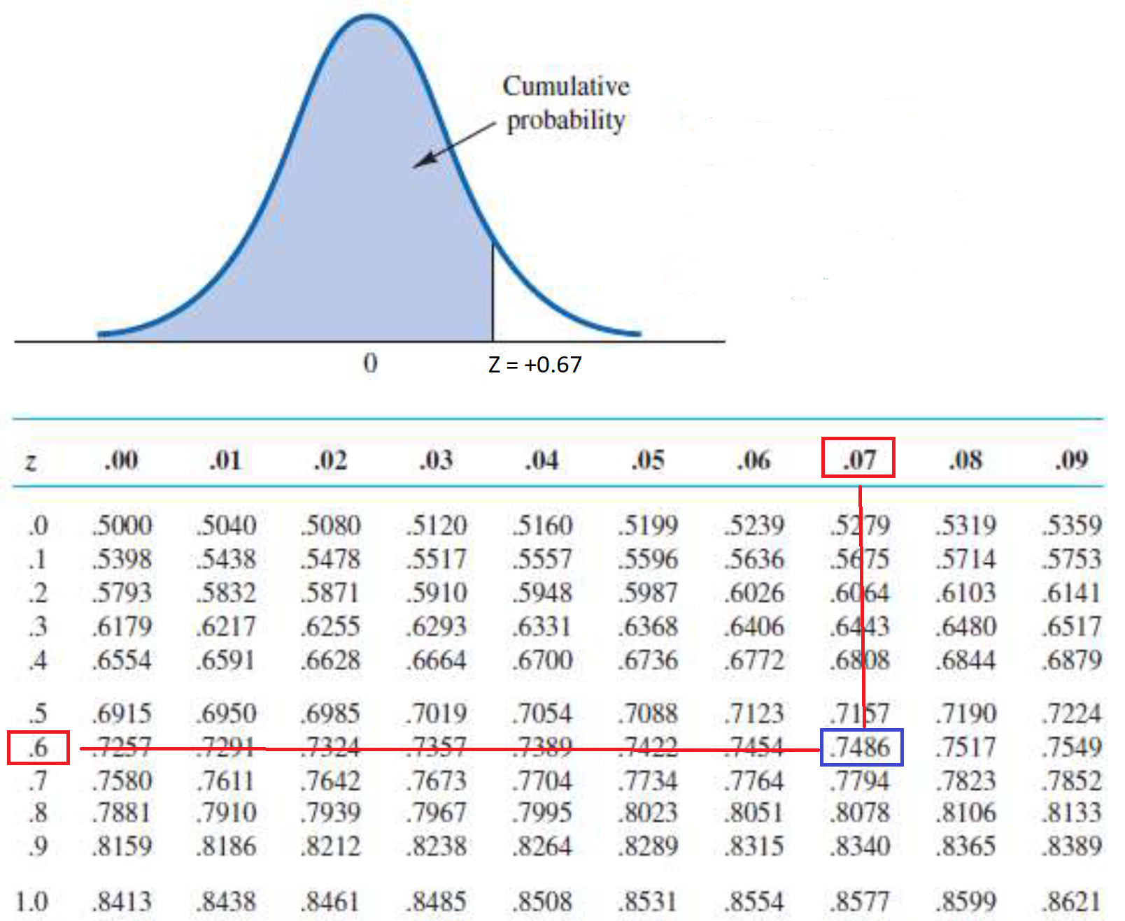
Forward Way - Example
Given a Z-score, find the cumulative area (or CA).
Example: Given Z = +0.67, find the CA.
1) Spitting the Z-score into two parts: +0.6 → row 0.07 → column
Ans: CA = 0.7486

Slide 11
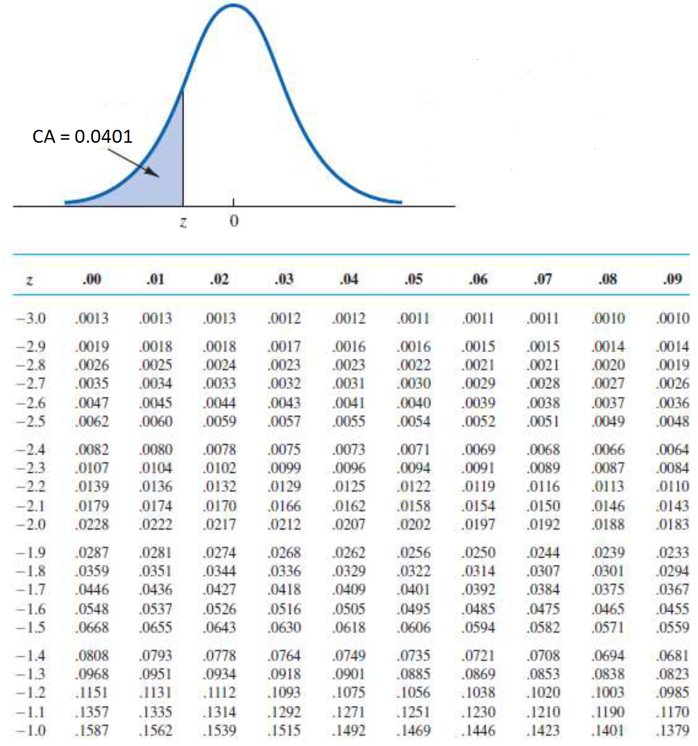
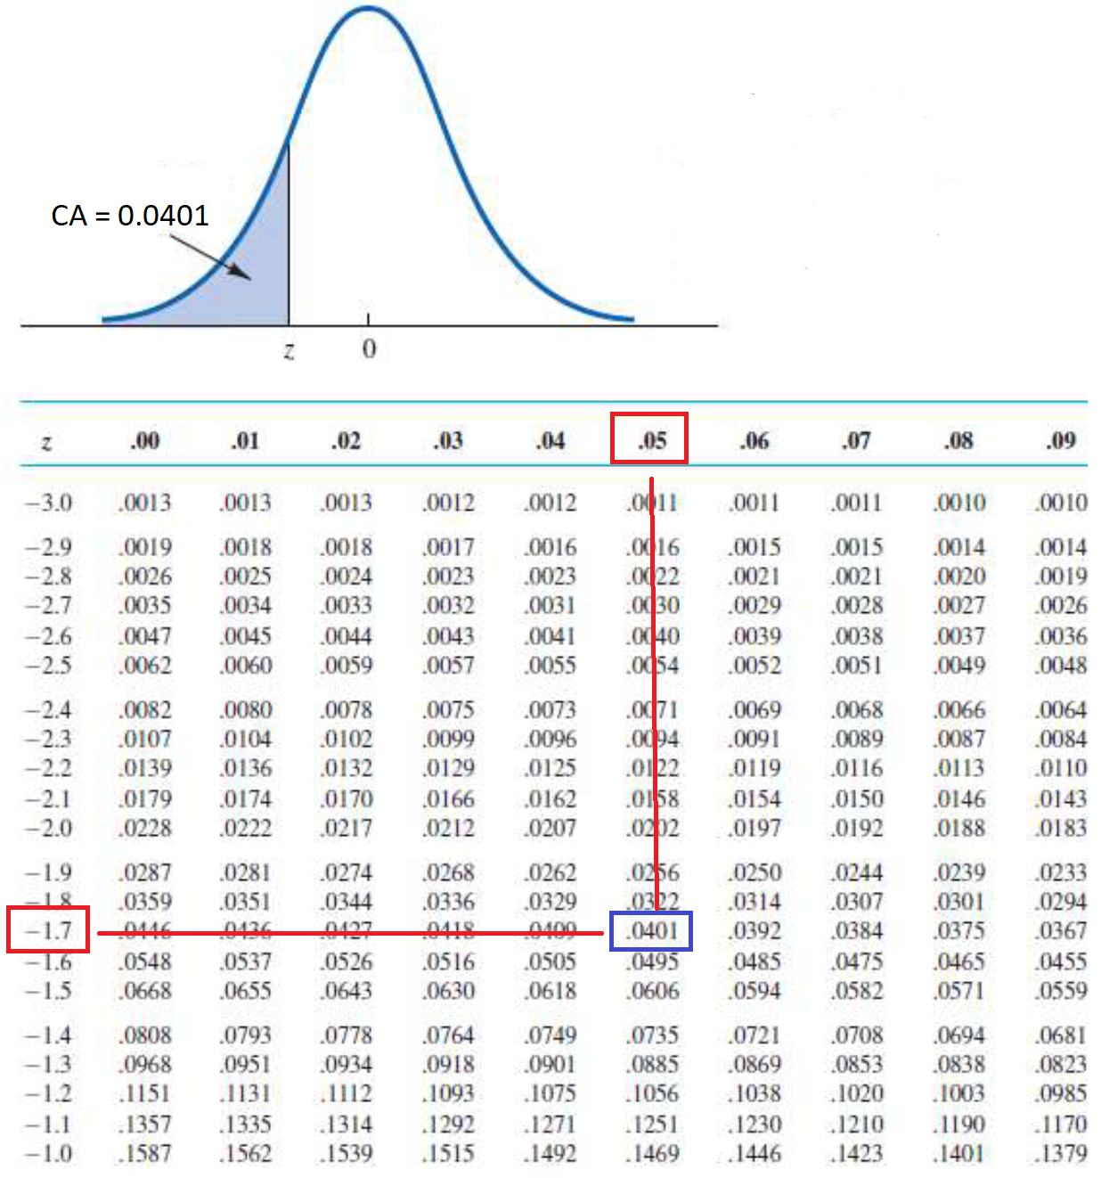
Backward Way - Example
Given a cumulative area (or CA), find the Z-score.
Example: given CA= 0.0401, find the Z-score.
With the CA of 0.0401, we get two parts of Z-score 1) -1.7 2) 0.05
We can combine them or simply add them up.
Ans: Z = -1.75

Slide 12
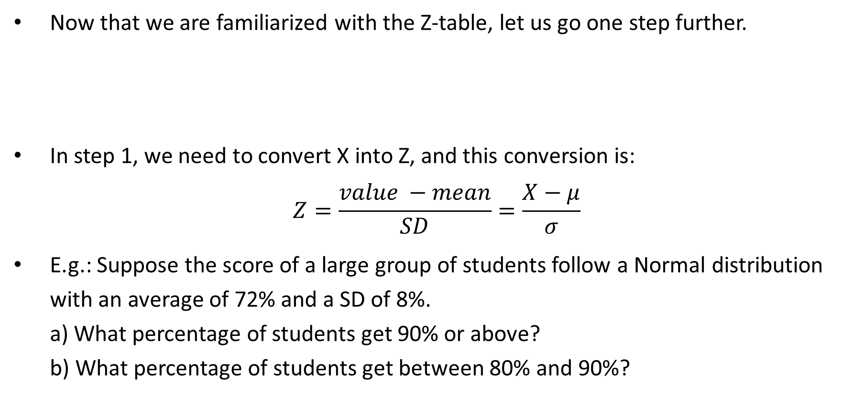
Forward Probability Calculations
Now that we are familiarized with the Z-table, let us go one step further.
In step 1, we need to convert X into Z, and this conversion is:
$$Z=\frac{value −mean}{SD}=\frac{X−μ}{σ}$$
E.g.: Suppose the score of a large group of students follow a Normal distribution with an average of 72% and a SD of 8%. a) What percentage of students get 90% or above? b) What percentage of students get between 80% and 90%?
Given | Step 1 Use Formula |  | Step 2 Use Z-Table | Want
X |  | Z-score |  | Area
Notes:
a)
Using Z-table
Step 1: Z = (90 – 72)/8 = +2.25
Step 2: With row “+2.2” and column “0.05”, the CA is 0.9878.
Remember that we want the area to the right of 90%.
Answer = 1 – 0.9878 = 0.0122 or 1.22%
Using R:
Both methods give you the same answer: 0.01222447
1-pnorm(90,72,8)
pnorm(90,72,8,lower.tail = FALSE)
b)
Using Z-table
There are two X’s but we had done one of them (X = 90). Here we will only focus on X = 80.
Step 1: Z = (80 – 72)/8 = +1.00
Step 2: With row “+1.0” and column “0.00”, the CA is 0.8413.
Remember that we want the area between 80% and 90%, so we will take the difference between the big area and the small area.
Answer = 0.9878 – 0.8413 = 0.1465 or 14.65%
Using R:
Both methods give you the same answer: 0.1464308
pnorm(90,72,8) - pnorm(80,72,8)
diff(pnorm(c(80,90),72,8))

Slide 13
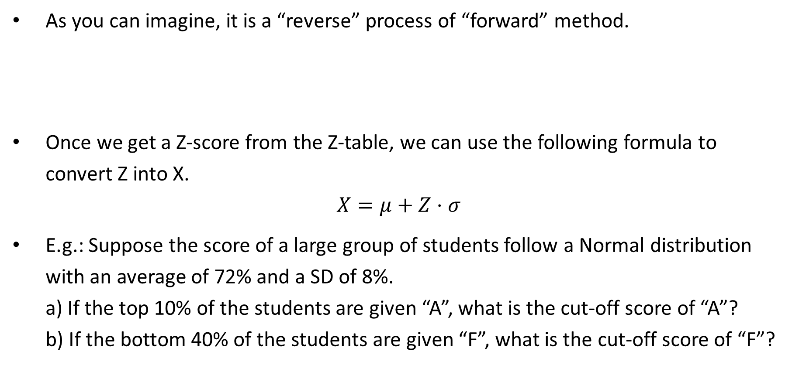
Backward Probability Calculations
As you can imagine, it is a “reverse” process of “forward” method.
Once we get a Z-score from the Z-table, we can use the following formula to convert Z into X.
$$X=μ+Z⋅σ$$
E.g.: Suppose the score of a large group of students follow a Normal distribution with an average of 72% and a SD of 8%. a) If the top 10% of the students are given “A”, what is the cut-off score of “A”? b) If the bottom 40% of the students are given “F”, what is the cut-off score of “F”?
Given | Step 1 Use Z-table |  | Step 2 Use Formula | Want
Area |  | Z-score |  | X
Notes:
a)
Using Z-table:
Step 1: Since the 10% or 0.1000 refers to the right hand tail, the CA is 0.9000.
Note that we can’t find CA of exactly 0.9000, but the closest one is 0.8997.
Using CA of 0.8997, the corresponding Z-score is +1.28
Step 2: X = 72 + 1.28*8 = 82.24.
Using R:
qnorm(0.9,72,8) gives 82.25241
b)
Using Z-table
Step 1: Using the CA of 0.4000, the closest number in the Z-table is 04013.
Using CA of 0.4013, the corresponding Z-score is -0.25
Step 2: X = 72 – 0.25*8 = 70
Using R:
qnorm(0.4,72,8) gives 69.97322

Slide 14
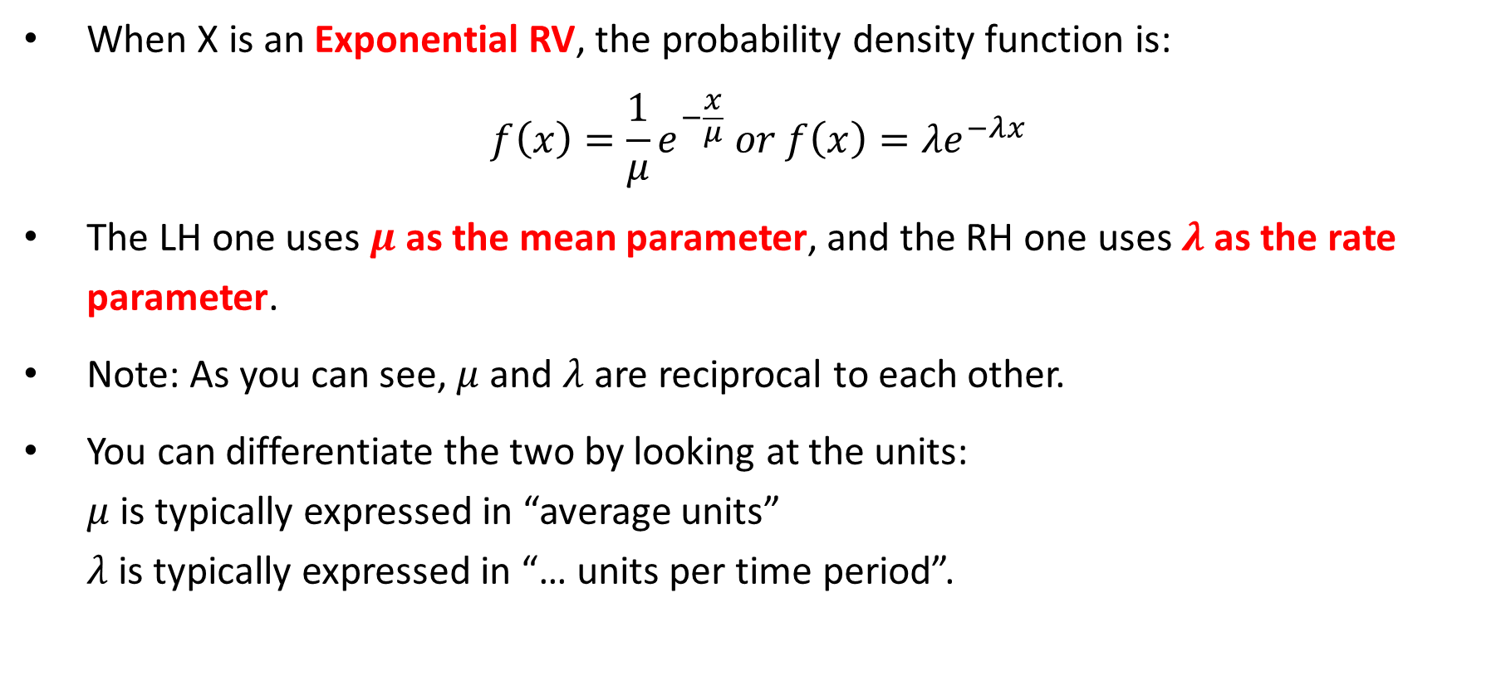
Exponential RV & Distributions
When X is an Exponential RV, the probability density function is:
$$f\left(x\right)=\frac{1}{μ}e^{−\frac{x}{μ}} or f\left(x\right)=λe^{−λx}$$
The LH one uses $μ$ as the mean parameter, and the RH one uses $λ$ as the rate parameter.
Note: As you can see, $μ$ and $λ$ are reciprocal to each other.
You can differentiate the two by looking at the units: $μ$ is typically expressed in “average units” $λ$ is typically expressed in “… units per time period”.

Slide 15
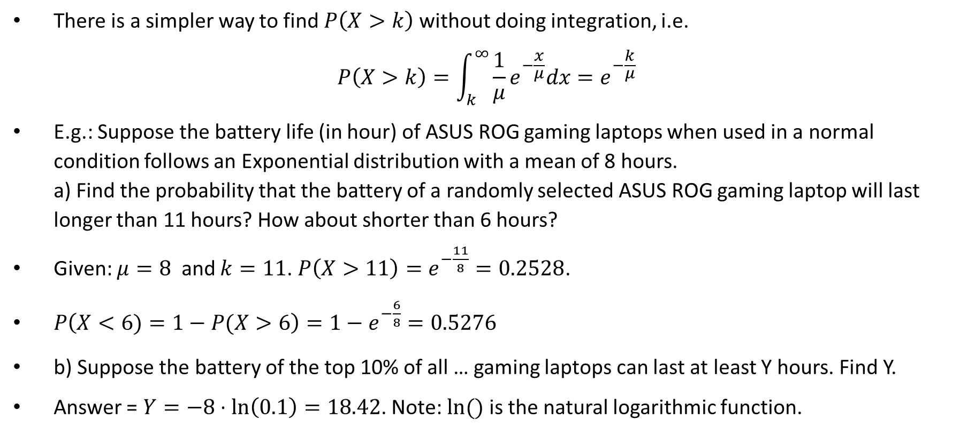
Exponential Probability Calculations
There is a simpler way to find $P\left(X>k\right)$ without doing integration, i.e.
$$P\left(X>k\right)=\int_{k}^{∞}{\frac{1}{μ}e^{−\frac{x}{μ}}dx}=e^{−\frac{k}{μ}}$$
E.g.: Suppose the battery life (in hour) of ASUS ROG gaming laptops when used in a normal condition follows an Exponential distribution with a mean of 8 hours. a) Find the probability that the battery of a randomly selected ASUS ROG gaming laptop will last longer than 11 hours? How about shorter than 6 hours?
Given: $μ=8$ and $k=11$. $P\left(X>11\right)=e^{−\frac{11}{8}}=0.2528$.
$P\left(X<6)=1−P(X>6\right)=1−e^{−\frac{6}{8}}=0.5276$
b) Suppose the battery of the top 10% of all … gaming laptops can last at least Y hours. Find Y.
Answer = $Y=−8⋅\ln\left(0.1\right)=18.42$. Note: $ln⁡()$ is the natural logarithmic function.
Notes:
Using R:
a)
P(X > 11) = 0.2528396
Any of the following will give you the same answer.
exp(-11/8)
pexp(11,1/8,lower.tail=FALSE)
pexp(11,1/8,FALSE)
P(X < 6) = 0.5276334
Any of the following will give you the same answer.
1-exp(-6/8)
1-pexp(6,1/8,lower.tail=FALSE)
pexp(6,1/8)
b)
P(X > y) = 0.10 -> Y = 18.42068
Any of the following will give you the same answer.
-8*log(0.1)
qexp(0.9,1/8)
qexp(0.1,1/8,lower.tail=FALSE)

Slide 16
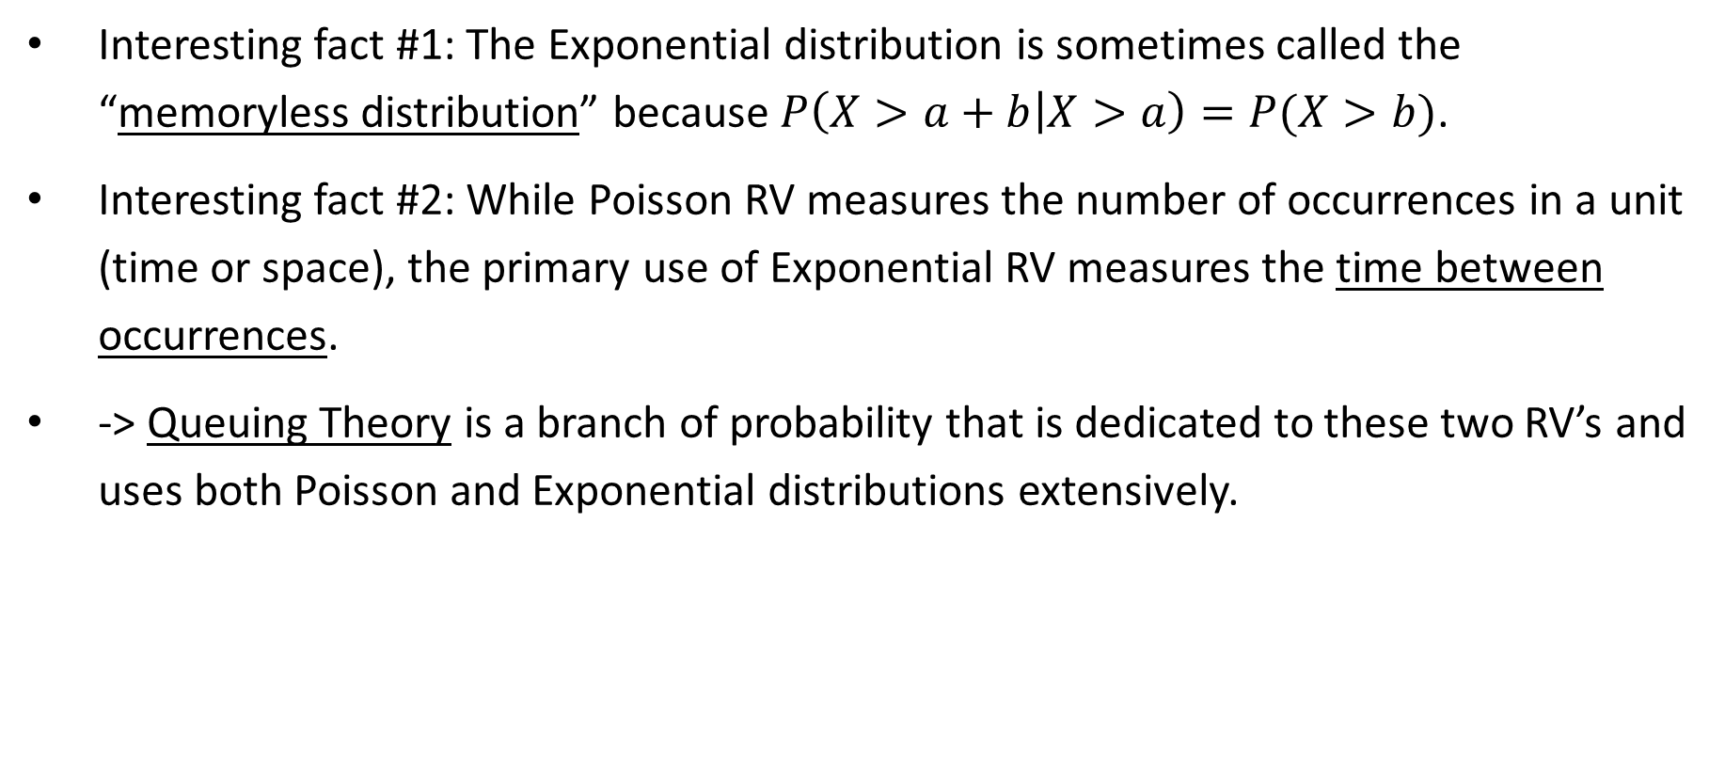
Exponential Probability Calculations
Interesting fact #1: The Exponential distribution is sometimes called the “memoryless distribution” because $P\left(X>a+b | X>a\right)=P(X>b)$.
Interesting fact #2: While Poisson RV measures the number of occurrences in a unit (time or space), the primary use of Exponential RV measures the time between occurrences.
-> Queuing Theory is a branch of probability that is dedicated to these two RV’s and uses both Poisson and Exponential distributions extensively.

Slide 17

Any Questions?

